Slide 1

Railway Perimeter Intrusion Alarm Management System - Technical Highlights
Software system for monitoring railway perimeter security

Slide 2

01
System Overview
02
Core Technologies and Implementation
03
Case Analysis and Application Results
content
Contents

Slide 3
01
System Overview

Slide 4

System Definition and Functions
01
02
03
04
System Definition
Core Functions
Intelligent Analytics
Remote Control
The Railway Perimeter Intrusion Alarm Management System is an advanced security system that uses sensors, cameras, and other devices to detect and identify abnormal intrusion behavior and issue timely alarms.
The system monitors perimeter conditions in real time, automatically distinguishes normal activity from potential threats, and enables immediate response to intrusion events, improving security.
AI algorithms analyze data to reduce false alarms and improve alarm accuracy. Historical-data analysis also supports informed security-management decisions.
Managers can access the system remotely over the network to adjust settings and view live monitoring video, enabling comprehensive, around-the-clock security management.

Slide 5




Application Scenarios and Importance
Security Requirements
Intelligent Detection
Crime Prevention
Emergency Response
The Perimeter Intrusion Alarm Management System is widely used in high-security locations such as railways, stations, and airports to prevent unauthorized intrusion and protect secured areas.
By integrating video surveillance, sensors, and AI, the system automatically identifies abnormal behavior, reduces false alarms, improves alarm accuracy, and enables timely response.
In critical protected areas, the system provides early warning of potential threats, helps prevent theft and vandalism, and protects property.
When an intrusion is detected, the system immediately triggers an alarm and links to video surveillance, providing security personnel with real-time information and accelerating emergency response.

Slide 6
02
Core Technologies and Implementation

Slide 7

Solution Overview
For railway perimeter intrusion, the solution combines vibration-sensing fiber, millimeter-wave radar, and intelligent cameras to detect targets and process alarms, delivering effective video-based perimeter detection and alerting.
Vibration-Sensing Fiber
Millimeter-Wave Radar
Video Analytics
Fiber-optic sensors detect external disturbances through changes in light propagation within the fiber, capturing abnormal vibration, pressure, and other signals along the perimeter.
Millimeter-wave radar transmits and receives millimeter-wave signals to monitor moving targets within perimeter areas, providing all-weather operation and long-range detection.
Using intelligent video analytics, the system automatically identifies and tracks suspicious behavior within the perimeter, improving alarm accuracy and response speed.

Slide 8
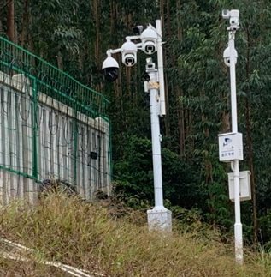
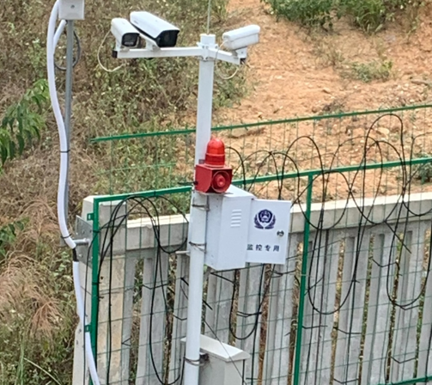
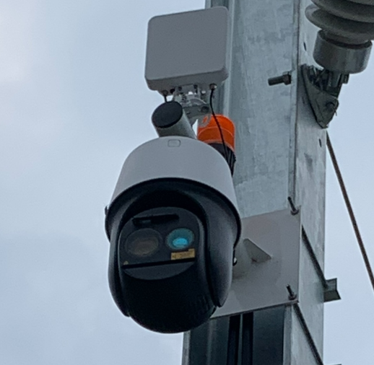
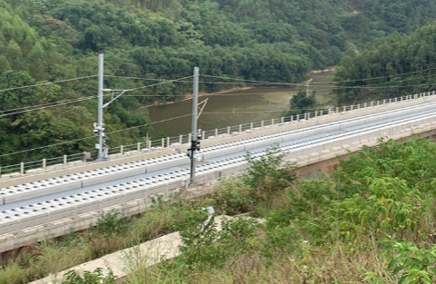
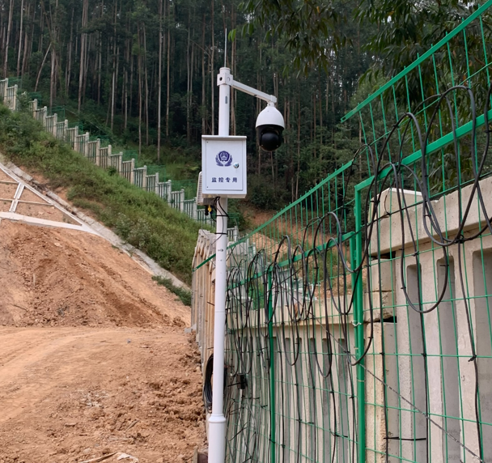
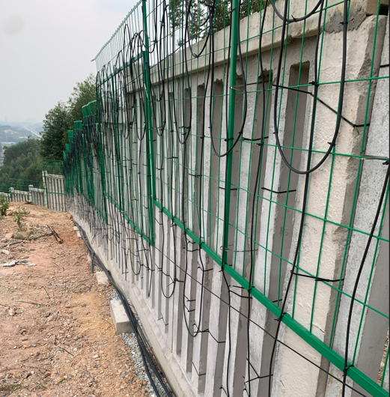
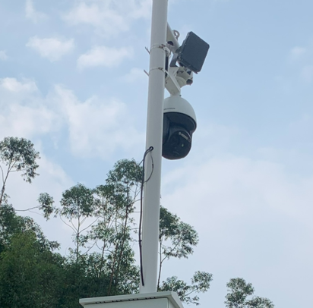
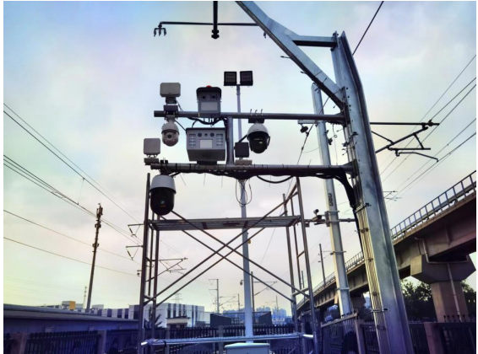
Detection Technologies and Devices
Vibration-Sensing Fiber + Video
Millimeter-Wave Radar + Video
Links vibration-sensing fiber with cameras to monitor people and animals.
Primarily used at tunnel portals and in areas readily accessible to people.
Links millimeter-wave radar with cameras to monitor people and animals.
Primarily used along open railway tracks.

Slide 9
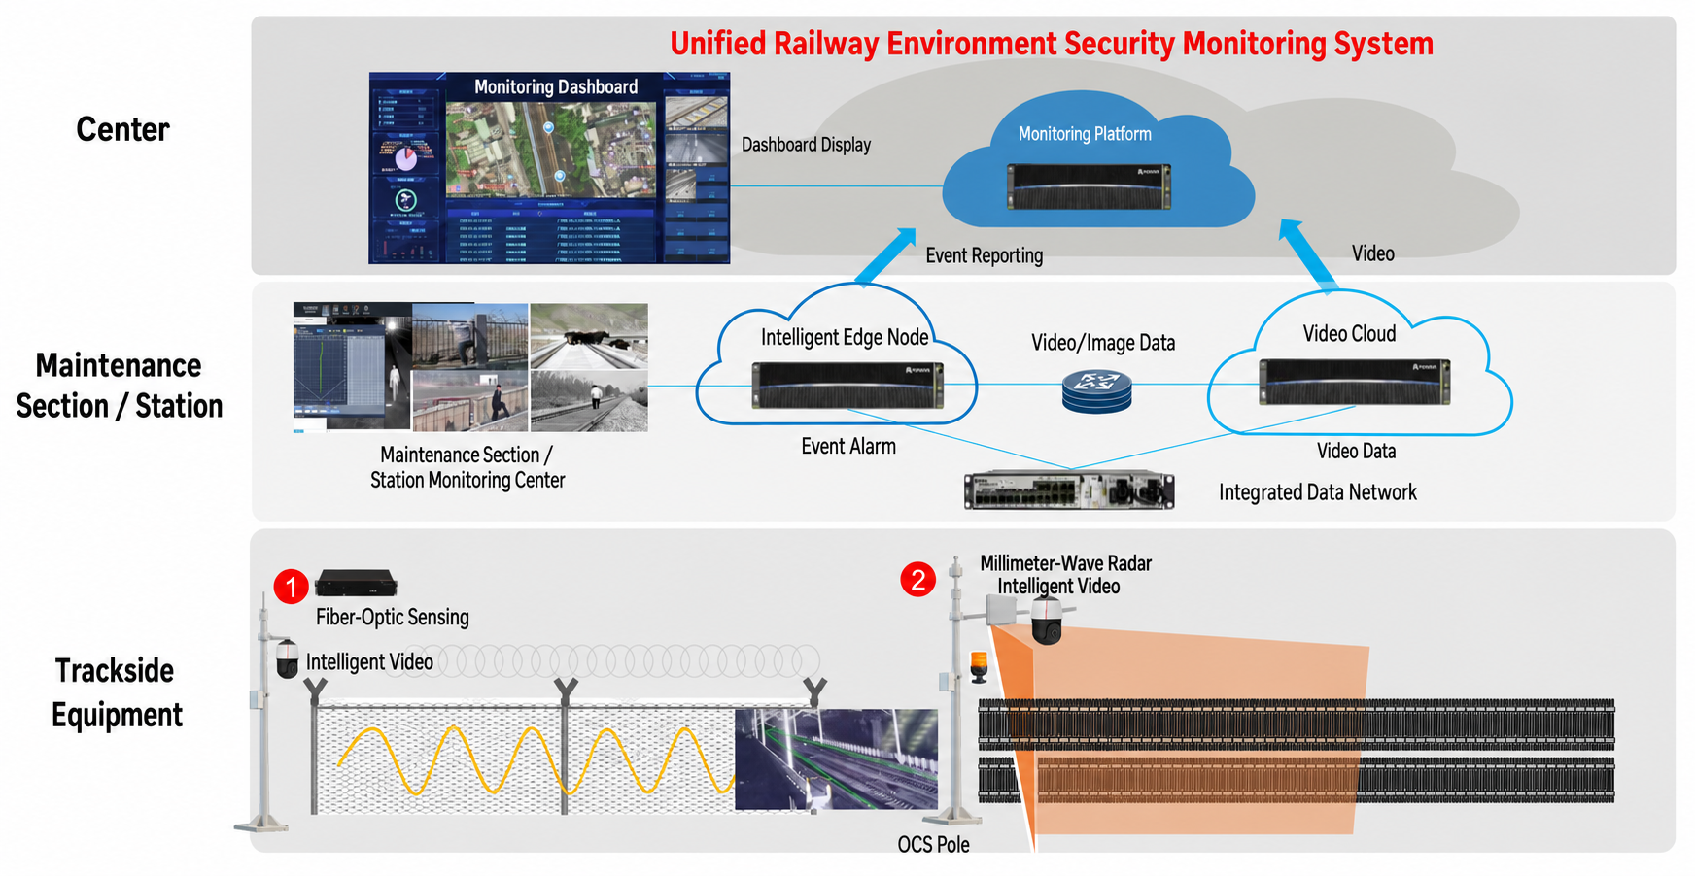
Overall Architecture: Multi-Sensor Fusion

Slide 10
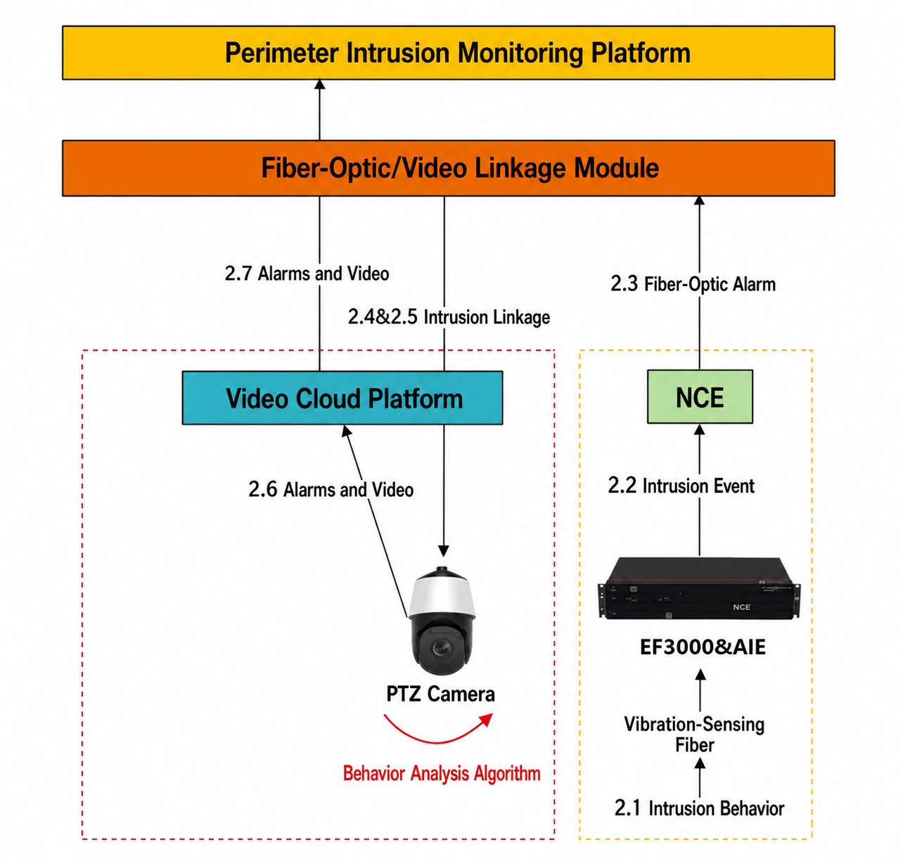
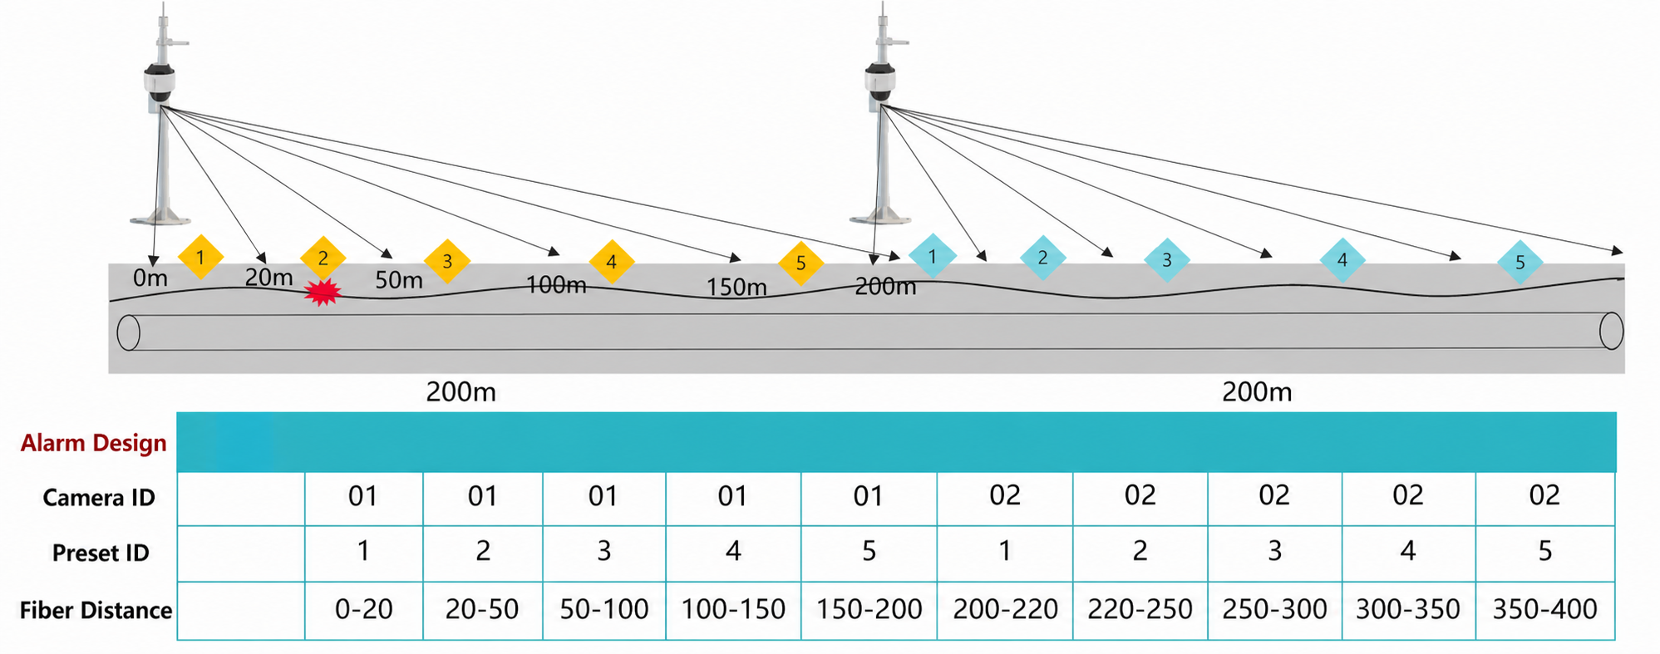
Fiber-Optic and Video Fusion Solution
Fiber sensing equipment detects intrusions and raises alarms. The linkage module directs a PTZ camera to capture verification images. The platform receives fiber-optic and video-analytics alarms, displays them, notifies personnel, and can activate on-site audible and visual alarm devices.

Slide 11
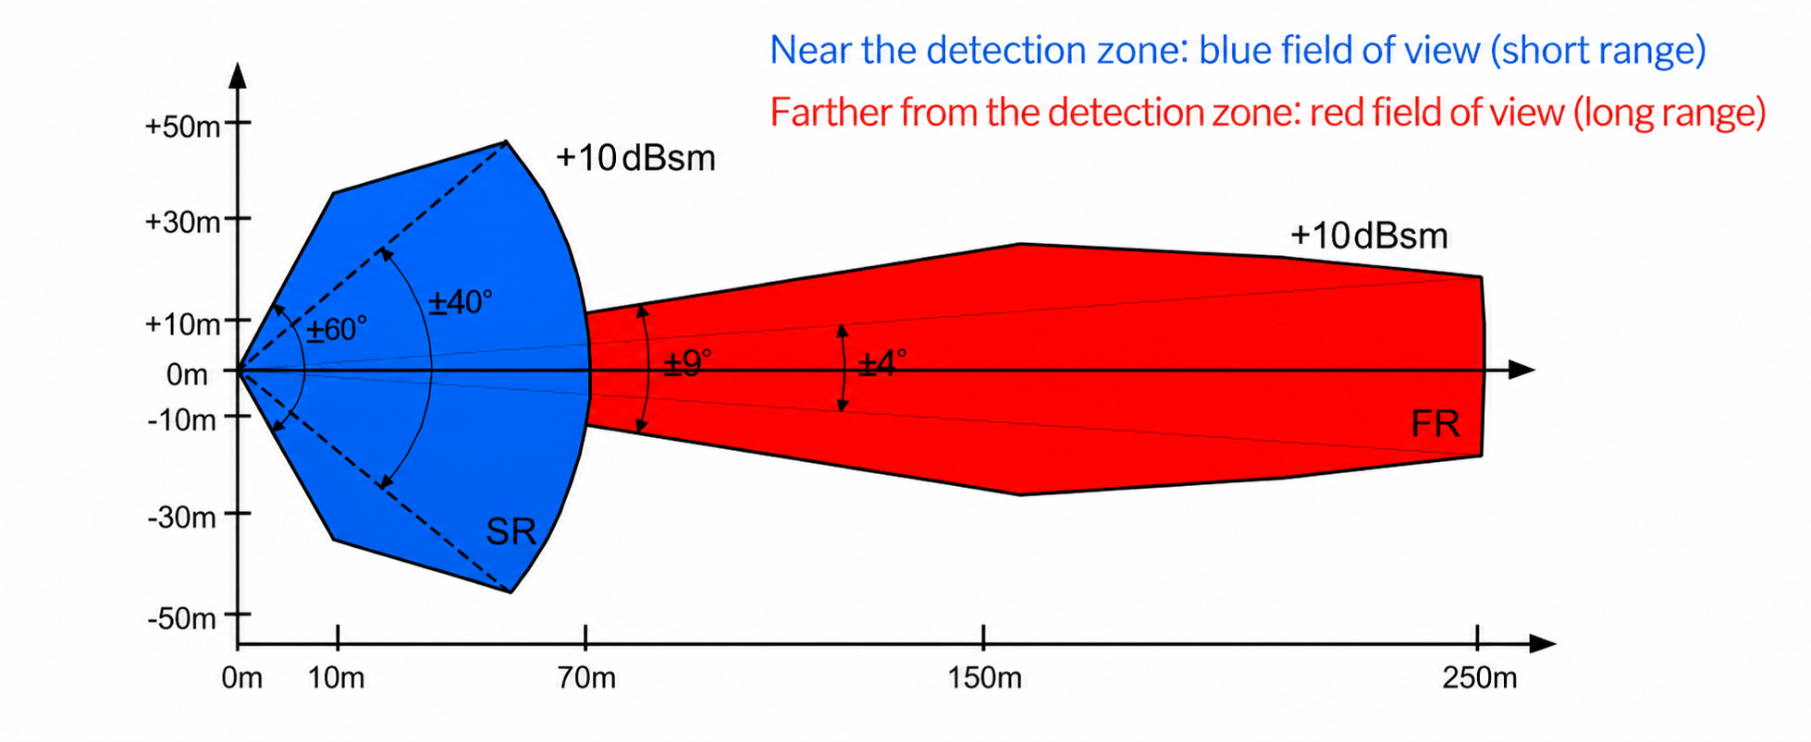
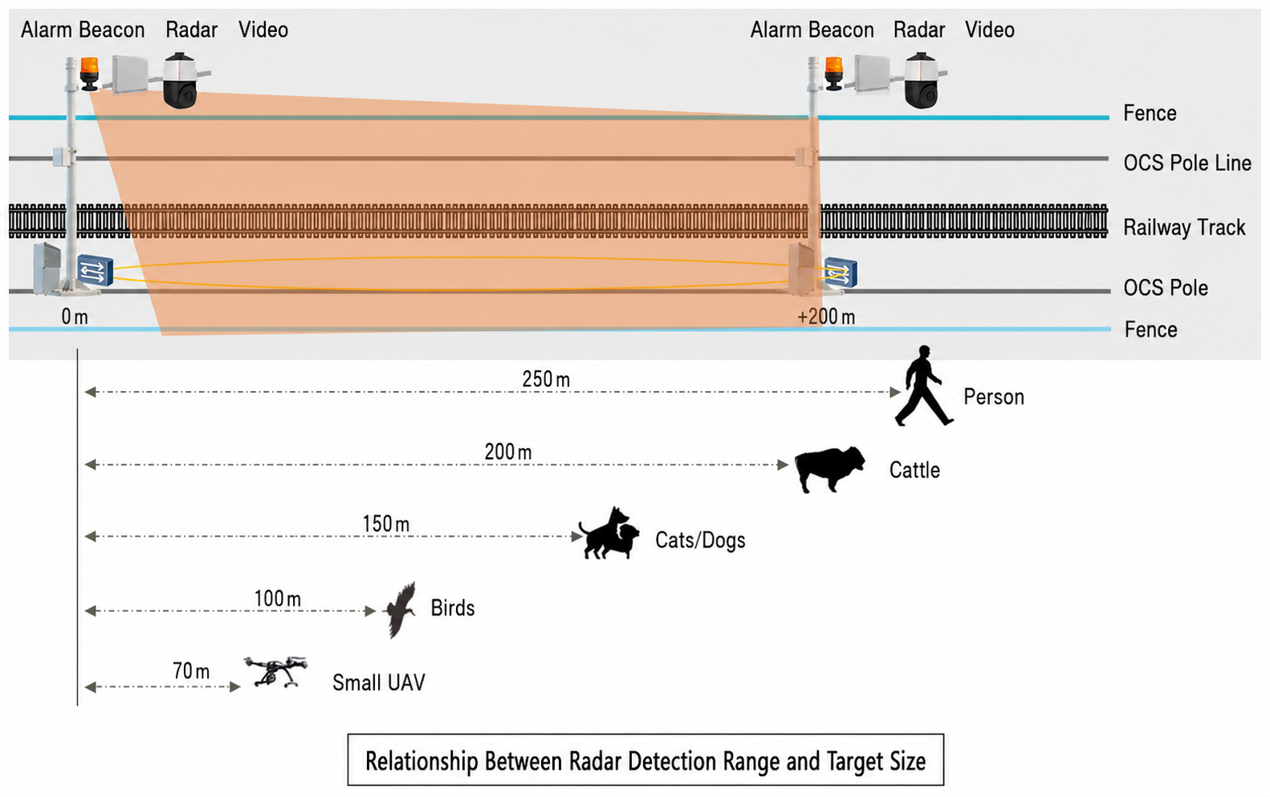
Radar and Video Fusion Solution
Radar detects intruding targets and raises alarms. The system directs a PTZ camera to capture verification images. The platform receives radar and video-analytics alarms, displays them, notifies personnel, and can activate on-site audible and visual alarm devices.

Slide 12
Intelligent Algorithms
Algorithm Foundation
Environmental Adaptation
Real-Time Processing
Intelligent analytics algorithms are fundamental to the Railway Perimeter Intrusion Alarm Management System. Deep learning and pattern recognition filter abnormal fiber-vibration waveforms and automatically detect abnormal behavior in surveillance video.
Adaptive algorithms adjust parameters for different environmental conditions, accurately identifying intrusions under varying weather and lighting conditions while reducing false alarms.
Efficient data processing and parallel-computing frameworks enable real-time monitoring and rapid response, providing immediate security alerts.

Slide 13
Alarm Mechanism and Response
Alarm Principle
Intelligent Detection
Rapid Response
Linked Control
The Railway Perimeter Intrusion Alarm System uses video, vibration-sensing fiber, millimeter-wave radar, and other technologies to monitor anomalies in real time, trigger alarms, and ensure security.
AI algorithms distinguish people, objects, and vehicles, reducing false alarms and improving alarm accuracy.
When an alarm occurs, the system immediately notifies security personnel, starts recording, and locates the intruder.
Integration with audible and visual alarm devices and other systems enables automatic protective actions and strengthens security.

Slide 14
03
Case Analysis and Application Results

Slide 15
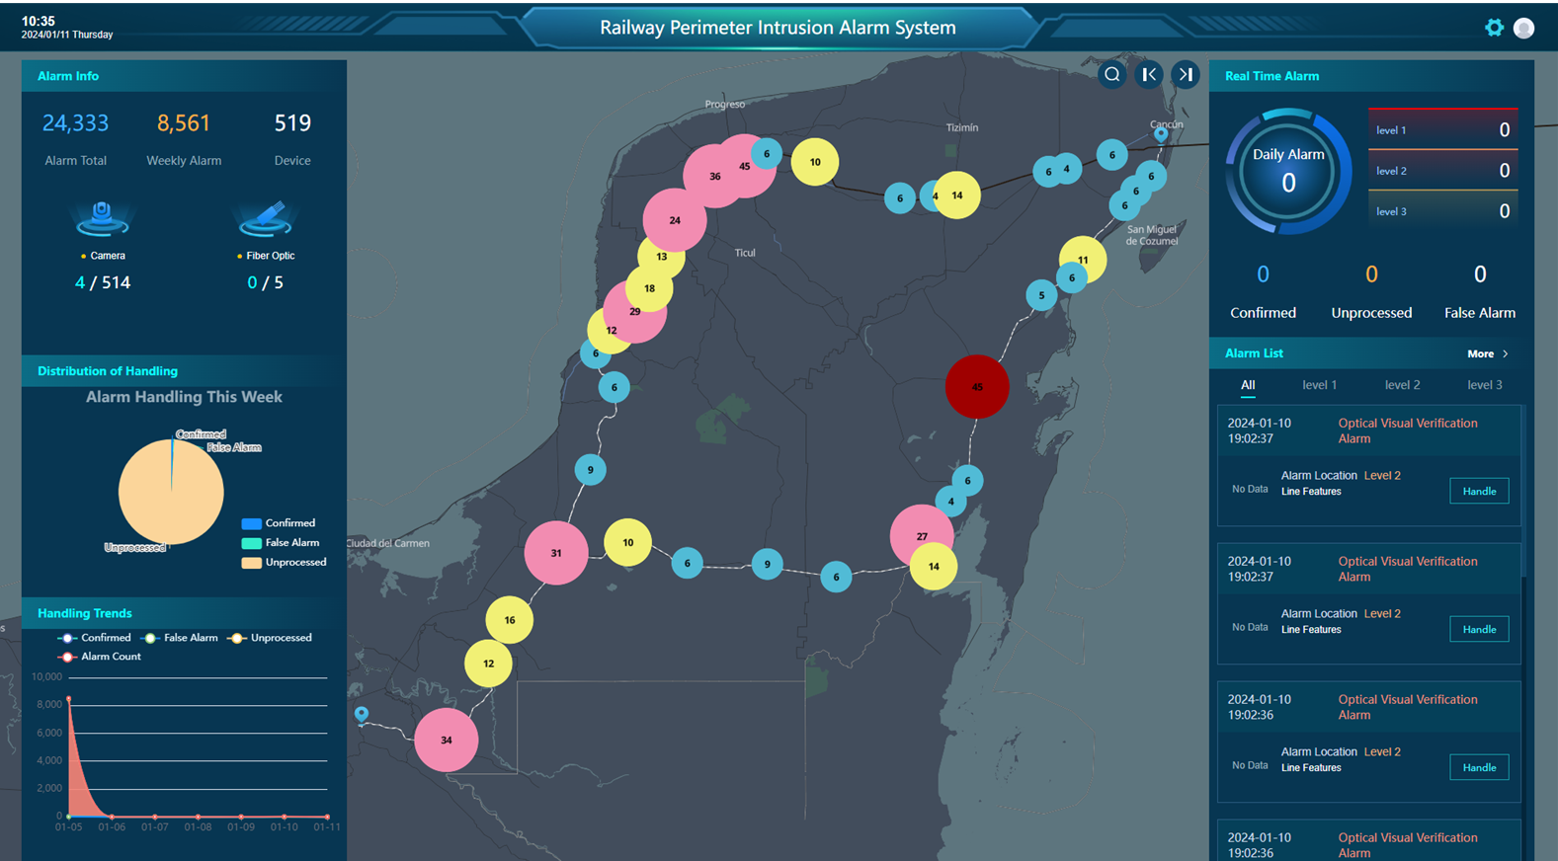
Deployment Case Study
01
Background
A major overseas railway faced nighttime perimeter-security challenges, with frequent unauthorized intrusions affecting operational safety.
02
System Deployment
The Railway Perimeter Intrusion Alarm Management System was deployed with vibration-sensing fiber and AI video analytics to provide 24/7 coverage and automatically detect abnormal intrusions.

Slide 16
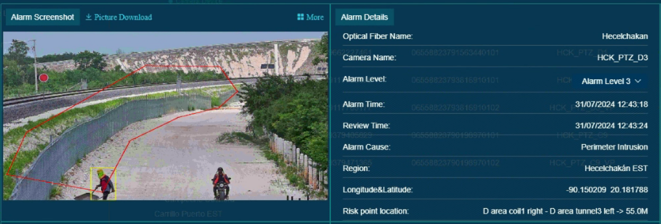
Actual Alarm Case
03
04
Application Results
Future Outlook
After deployment, the system effectively monitored unauthorized intrusions and improved site security management.
As the technology evolves, the algorithms will be further optimized to improve detection accuracy and build a more comprehensive security system.

Slide 17
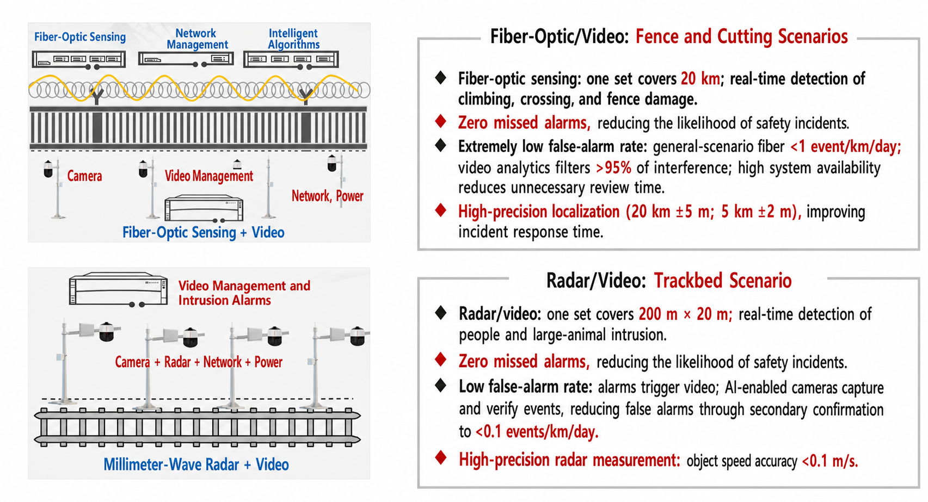
Performance Metrics

Slide 18
THANKS

